Slide 1
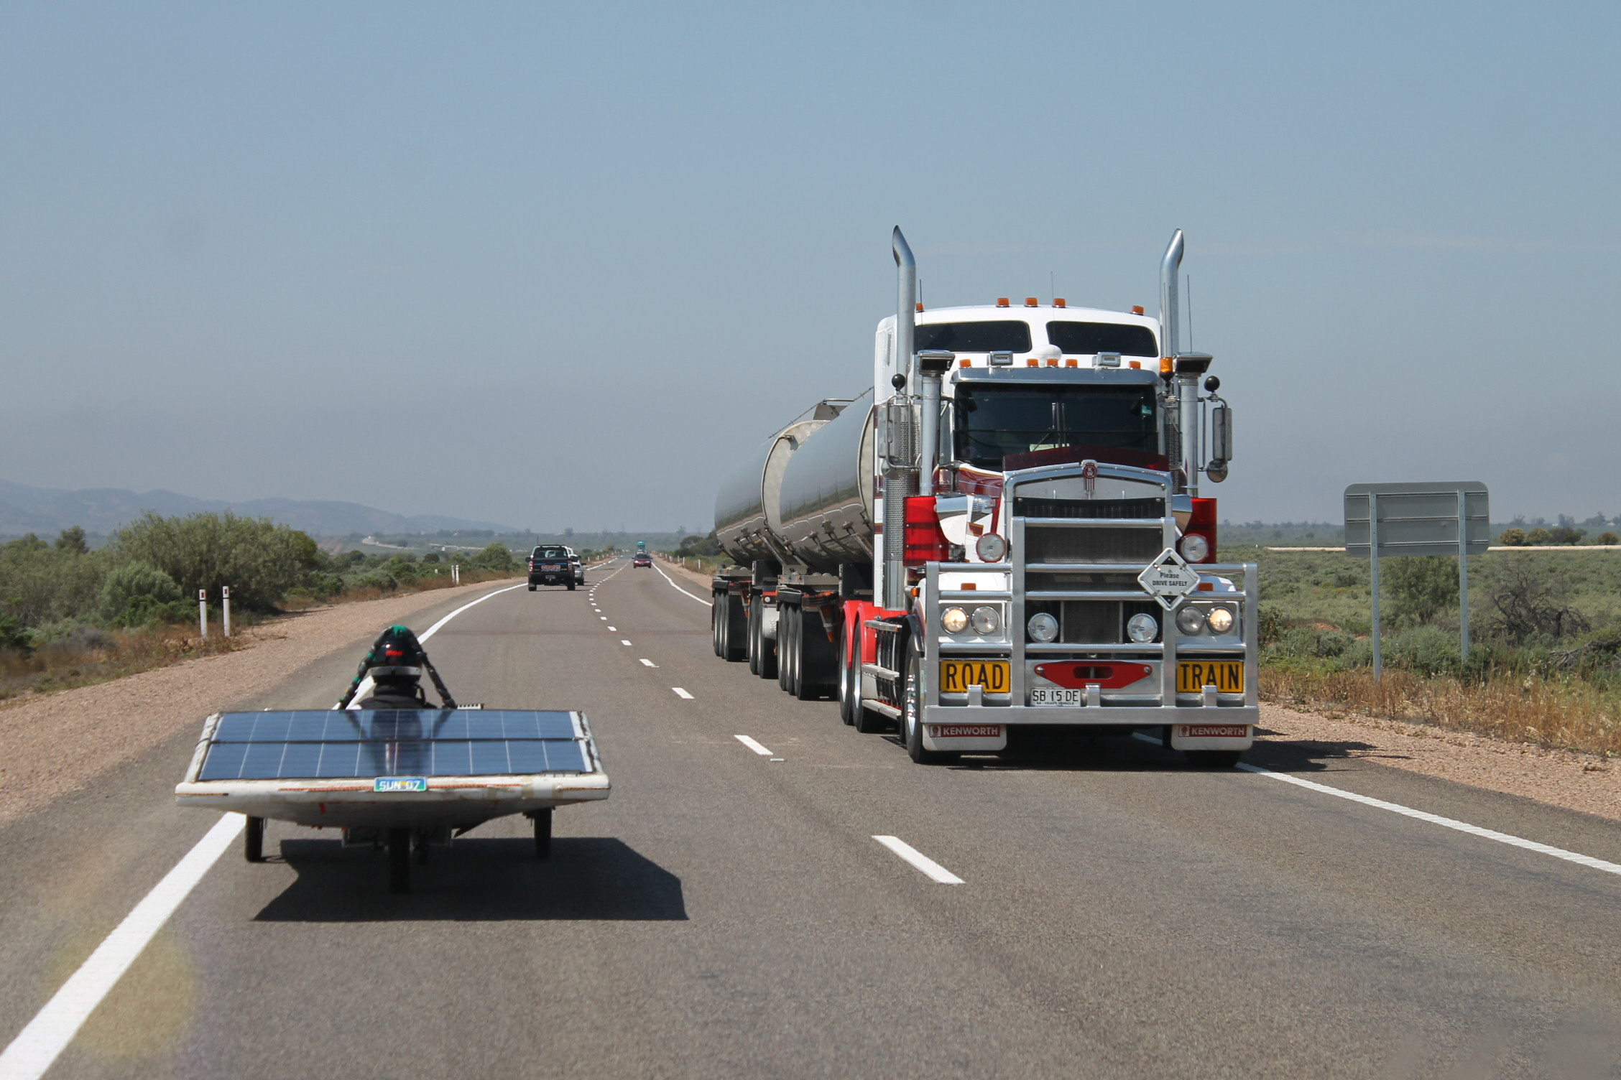
DTU SOLARIS
TOWARDS A GREENER FUTURE

Slide 2
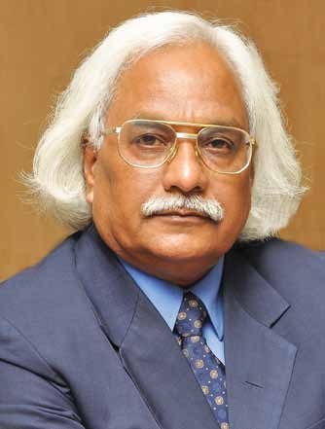
Message from Vice Chancellor, DTU
We in India are sitting on a goldmine of opportunity to harness solar energy in plenty and thus assure energy security for our billion people.
Solaris is one of the most prestigious projects at DTU, a pioneer in the field of innovations. We aim to develop a new ages solar car, thereby marking a new beginning in the field of solar automobile technology.
The team Solaris of DTU is venturing into creating a new age solar vehicle to participate in the North American solar challenge, June- July 2014.
Prof. P.B. Sharma
Hon’ble Vice Chancellor, DTU
(Ph.D-B’ham, FIE, FAeroS, FWPS, FISTE)

Slide 3
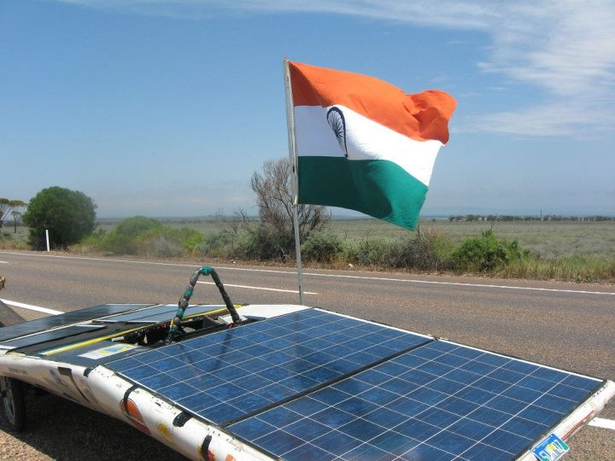
ABOUT US
Project Solaris is a recognized student-faculty run research project at Delhi Technological University (formerly Delhi College of Engineering) initiated in the year 2006. The Project aims at developing a highly efficient solar electric vehicle to provide a breakthrough in the application of solar technology to the transportation sector. Our prime goal is the development of an energy efficient passenger SEV suitable for Indian roads. Fuelled by its members’ passion for environment friendly and sustainable technologies, the team is dedicated to encourage the use of photovoltaic technology to meet the energy requirements of the future.

Slide 4
MILESTONES

Slide 5
North American Solar Challenge
The American Solar Challenge is a competition to design build and Solar powered cars in a cross-country time/distance rally event. Teams compete over a 1200 to 1800 mile course between multiple cities across the country. The event has had over two decades of organised events in North America.
June-July, 2014

Slide 6
The Route Map

Slide 7
BODY DESIGN OVERVIEW

Slide 8
POWER FLOW DIAGRAM

Slide 9
AUXILIARY AND TELEMETRY SYSTEMS OVERVIEW

Slide 10
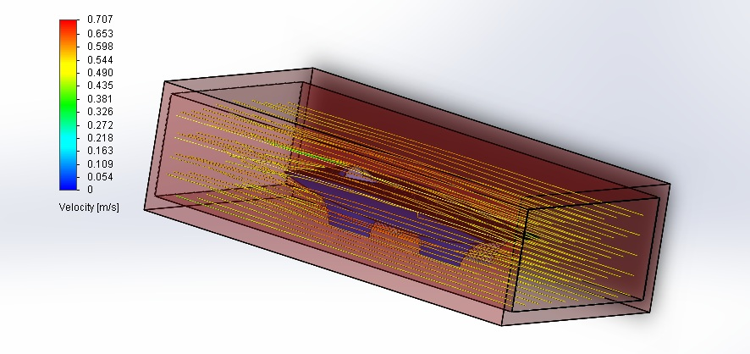
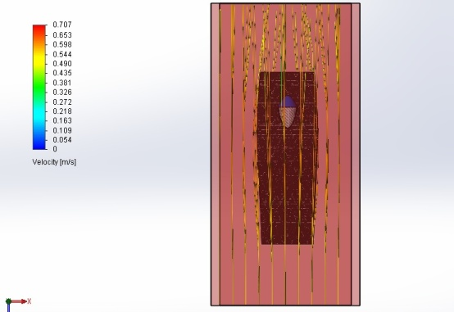
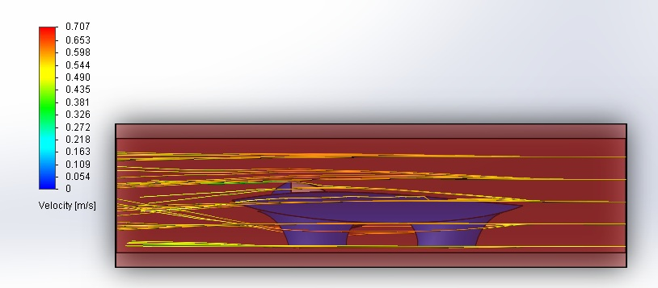
Body Design Simulations
Trimetric View
The following is a depiction of the
Computer simulations done on the
Design using Solidworks.
Top View
Side View
Rear View

Slide 11
CHASSIS DESIGN OVERVIEW

Slide 12
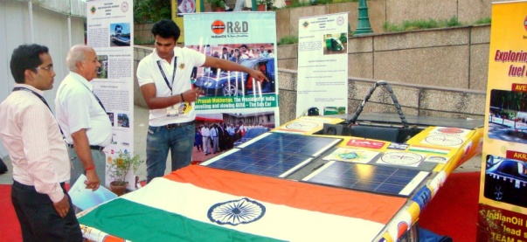
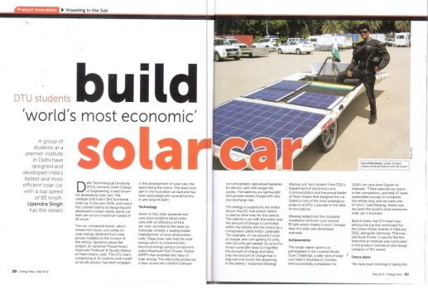
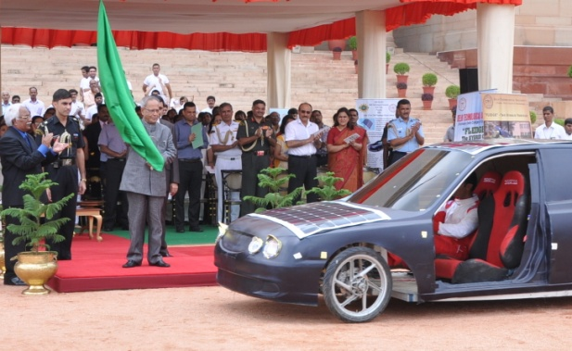
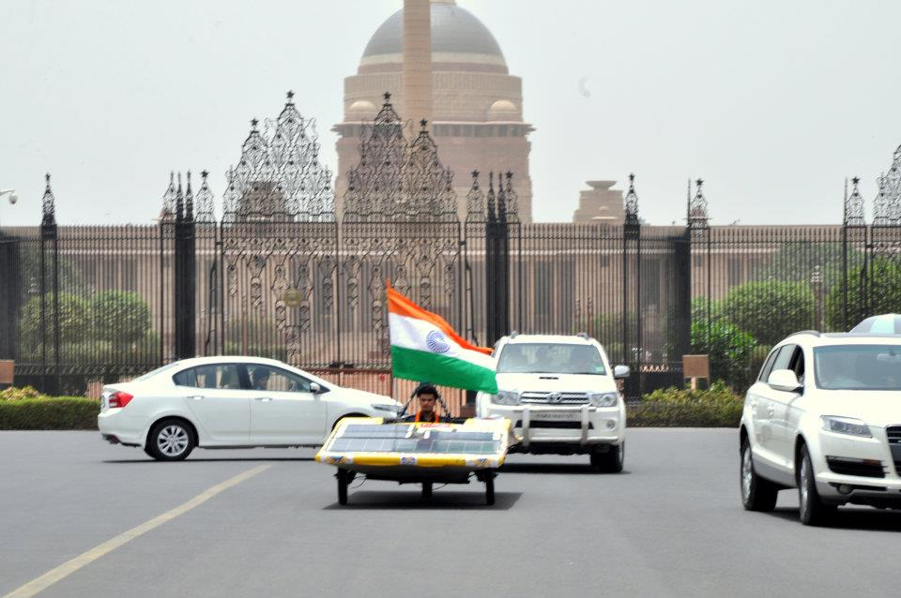
Why Collaborate with us?
International and National recognition as sponsors of green technology
Media attention.
Logo On
Car
Website
Team Merchandise
Official Team Documents and Brochures
You invest thousands and lakhs of rupees in advertisements to promote your company. Why not support us? We offer you advertisement and that too in a productive way.

Slide 13
Be Our Partner
Platinum
Sponsorship
(Rs.10,00,000 and above)
The name of the title sponsor will occur in conjugation with the car name and will be referred as “Company Name-Car Name”.
Name and logo on :
all merchandise and identity cards worn by the team.
A 12” x 12” logo on the solar vehicle.
On the official website .
Banners, flags, hoardings etc. will be displayed wherever the car is showcased.
The company can organize an exhibition of the car with the team at an event.
Special Mention of the sponsor will be made during all important exchange talks at various places wherever the car is showcased.
Gold
Sponsorship
(Rs.5,00,00 to 10,00,000)
The name of the title sponsor will occur in conjugation with the car name and will be referred as “Company Name-Car Name”.
Name and logo on :
all merchandise and identity cards worn by the team.
A 10” x 10” logo on the solar vehicle.
On the official website .
Banners, flags, hoardings etc. will be displayed wherever the car is showcased.
The company can organize an exhibition of the car with the team at an event.
Special Mention of the sponsor will be made during all important exchange talks at various places wherever the car is showcased.

Slide 14
Associate
Sponsorship
(Rs. 2,50,000 – 5,00-000)
Name and logo on:
All merchandise worn by the team.
7” x 7” on the Solar Vehicle
The official website of the team.
Logo of the company will be put up on the banners wherever the car is showcased.
Mention of the sponsor will be made during all important exchange talks at various places wherever the car is showcased.
Class Sponsorship
(Rs. 1,00,000 – 2,50,000)
Name and logo on:
All merchandise worn by the team.
5” x 5” on the Solar Vehicle
The official website of the team.
Banners will be displayed wherever the car is displayed.

Slide 15
Our Team
Name | Designation | Year & Branch
Prashant Kumar | Team Head | 3rd year, Mechanical
Aakash Vats | Team Coordinator | 3rd year, Mechanical
Aakash Katwalia | Mechanical Head | 3rd year, Mechanical
Anurag Arya | Electrical Head | 3rd year, Electrical
Saurabh Gupta | Telemetry Head | 3rd year, Electronics
Anav Malik | Mechanical Member | 2nd year, Mechanical
Devanshu Singla | Mechanical Member | 2nd year, Mechanical
Arush Kakkar | Electrical Member | 2nd Year, Electronics
Edwin B Matthew | Electrical Member | 2nd year, Electronics
Saksham Agrawal | Electrical Member | 2nd year, Electrical

Slide 16
Our Past Sponsors

Slide 17
Special Thanks
Dr. JP Kesari
Associate Professor
Faculty Head, DTU Solaris
Department of Mechanical Engineering
Delhi Technological University
Ph.: 011-27294673
E-mail: drjpkesari@gmail.com

Slide 18
Contact Information:
Dr. J.P. Kesari +919313806926
Prashant Kumar +918750280427
Email us at :
solarcar.dce@gmail.com

